Slide 1
March School-Based Family Data Night
Notes:
Welcome to (insert school’s name) November School-Based Family Data Night!

Slide 2
VISION FOR STUDENT SUCCESS

Slide 5
Agenda
Purpose of School-Based Family Data Night
School’s Current Data and Academic Goals for 2021-2022
Assessment & Intervention Overview
SCS Commitment to Our Students
Student Data Discussion Transition
Next Steps & Closure

Slide 6
Purpose
Inform parents on student progress with various assessments
Provide guidance on how to read data reports
Provide recommendations on how to assist students
Notes:
Why are we here? The purpose of this family data night is to inform parents on student progress with various assessments, provide guidance on how to read data reports, and provide recommendations on how to assist students.

Slide 7
School’s Current Data and Academic Goals

Slide 8
School’s Data and Academic Goals

Slide 9
Accessing and Viewing the Report Card

Slide 10
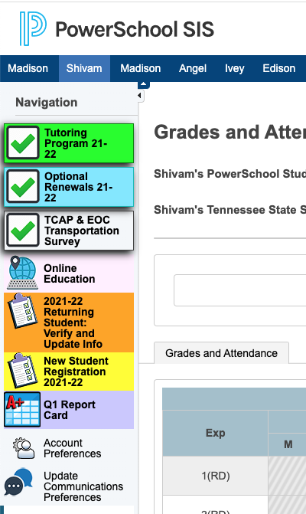
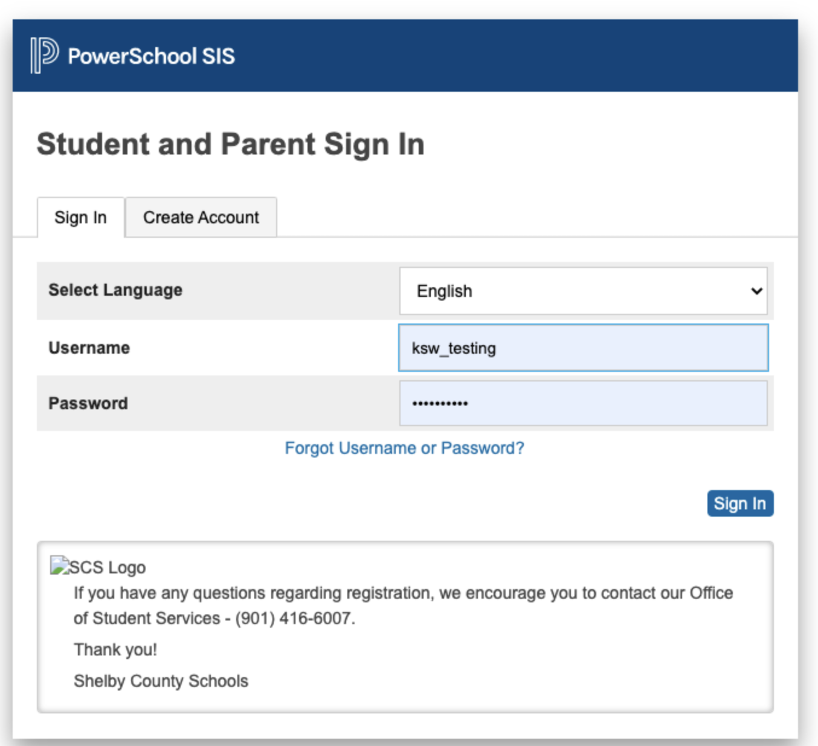
Accessing and Viewing the Report Card
Report cards will be available for the complete quarter once all school grades are stored and will be housed in the parent portal.
Access the report card, using the following link: https://scstn.powerschool.com/public/home.html
Sign into your parent account.
If you have forgotten the username or password, click on the “Forgot Username or Password” link.
After logging in, click the report card icon.

Slide 11
Accessing and Viewing the Report Card

Slide 12
District Assessments & Intervention
Notes:
Now we’re getting ready to provide an overview of the different assessments and interventions your child might be taking. Once we’ve reviewed this information, you will have the opportunity to meet with your child’s teacher to discuss your child’s individual data.

Slide 13
iREADY
iReady is a computer-adaptive test (CAT).
Computer-adaptive tests continually adjust the difficulty of each test by determining each question based on the previous response.
The iReady assessment is used as a diagnostic screening tool to identify students who may need additional academic support and monitor student growth.
iReady is a K-8 intervention that provide specific tools and lessons to support areas the individual student is struggling.
In addition, iReady can help teachers determine appropriate instructional areas and skills to focus on during small group intervention instruction.

Slide 14
ILLUMINATE/FASTBRIDGE
Grades K-12 will participate in skill-based reading and math screener assessments.
Illuminate/FastBridge is the selected RTI² assessment platform for students in grades K-12.
Illuminate Education can be used in both special education and regular education in order to meet the state guidelines related to effective implementation of RTI².
Illuminate Education provides in-depth information on students' strengths and areas of need for specific skills in reading and math.
The goal of the process is to monitor student progress as the student receives intervention with the expectation that the intervention will result in the student achieving at high levels of learning while closing the achievement gap among same-age peers.

Slide 15
MASTERY CONNECT
Grades K-12 will participate in standards-based assessments aligned with district ELA, math, and science curriculum maps.
Mastery Connect is an assessment platform that allows teachers to assess student mastery of specific standards.
Students can receive results instantly.
The results are displayed by standard, so although students will still get an overall percentage on any assessment taken, the focus is on the mastery of the specific standards.

Slide 16
MasteryConnect Data

Slide 17
Mastery Connect – District Formative Assessments

Slide 18
Mastery Connect – District Formative Assessments

Slide 19
Mastery Connect – District Formative Assessments
School should insert slide for Math (grade level/course performance)

Slide 20
Mastery Connect – District Formative Assessments
School should insert slide for Science (grade level/course performance)

Slide 21
iReady Data

Slide 22
I-Ready Fall Diagnostic: READING

Slide 23
I-Ready Fall Diagnostic: Math
Screenshot of iReady Diagnostic Math Data

Slide 24
Illuminate/Fastbridge Data

Slide 25
Illuminate/Fastbridge : Video

Slide 26
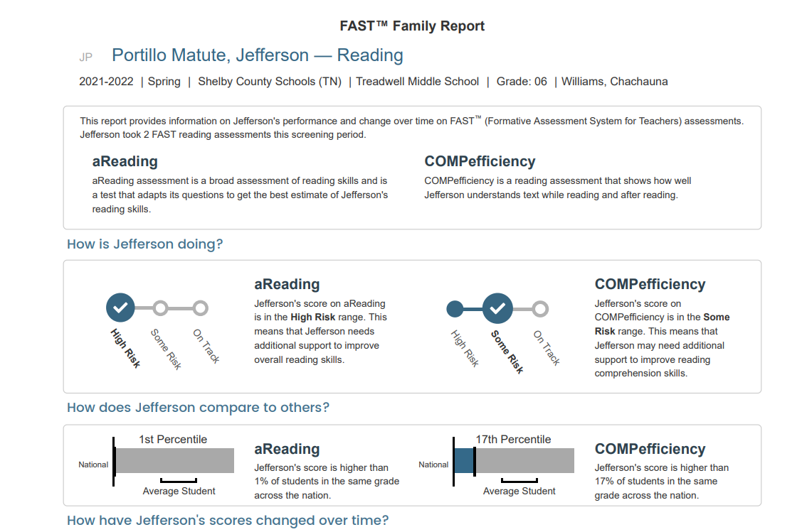
Illuminate/Fast bridge
SAMPLE REPORT

Slide 27
Shelby County Schools
Family and Community Engagement

Slide 28
Family and Community Engagement Ongoing Support
Monthly Family Forums: provide an opportunity for all parents to gather, learn and share important information to support student learning and success in school. Families can join the live virtual sessions on Microsoft Teams by visiting www.scsk12.org/familyforum

Slide 29
Family and Community Engagement Ongoing Support
Homework Hotline: Certified Teachers tutor K-12 Tennessee students in all core subjects
Help is offered in seven languages: English, Arabic, Spanish, Hindi, Farsi, Mandarin, and Swahili.
Teachers are available Mondays-Thursdays, 4p.m.-8p.m. via phone (901)416-1234 and webchat http://homeworkhotline.info/

Slide 30
Family and Community Engagement Ongoing Student Support
$5,000 for new library books for our library
$2,500 for blended learning supplies
Every student will receive a free chapter book to take home and keep.

Slide 31
Grade Level
Student Data Discussions
Notes:
Provide next steps for parents to review their child’s data
Share available resources for interpreting reports

